Slide 1
Shape Summaries A great strategy for reading large amounts of information
YOU will gain a deeper understanding of your readings if you read CHUNKS of information rather than large slabs.
In this reading strategy, students use shapes to code different types of information as they read. For example:
= Important facts and information
= Key words in the text
= Any information that is puzzling or questions needed to ask.
Notes:
Get images of chocolate to demonstrate this.

Slide 2
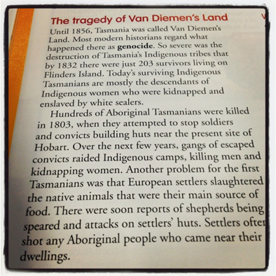
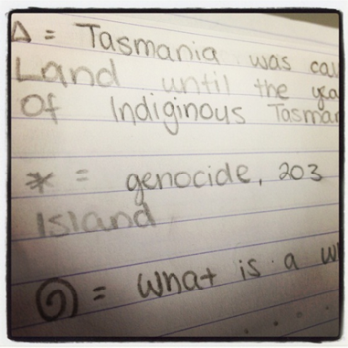
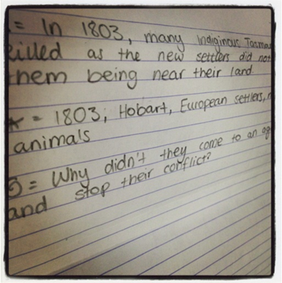
Shape Summaries A great strategy for reading large amounts of information
Complete a shape summary for each of the paragraphs or chunks of information you read.
At the end of their reading and completion of their shape summaries, you are to write a detailed summary of everything you have read. (using only their shape summaries)
You will be amazed by how much you are able to write.

