Slide 1
Nation Race and Citizen revision lecture 2013
AUSTRALIAN HISTORY

Slide 3
THE EXAM
Nation, Race and Citizen 1880- 1914
Worth 20 marks write in 30 mins
There will be approximately three questions (4, 6 and 10 mark questions)
Lines and mark allocation will suggest how much to write
The questions will focus on:
The Vision of Nationhood
The way in which the Vision of Nationhood was implemented i.e. Hopes and Fears; Who was Included and Excluded; Processes of Inclusion and Exclusion; the Benefits and Responsibilities of Citizenship as reflected in the Legislation between 1901 and 1914
You must answer all three parts of Question 2 i.e. a; b; c.

Slide 4
Order! Order!
There is no right or wrong way to approach the exam, however, YOU MUST endeavour to complete ALL sections.
The ONLY way to ensure that you will stay on task and to time is to PRACTICE – and to do so under timed conditions.

Slide 5
OPTIONS
Option 1
A-B-C-D (in the order you learned it)
Option 2
D first (freshest, and last thing you read during reading time. Also, questions are known ahead of time)
Option 3
Plan C essay response first ( minutes only) then return to your preferred order before coming back to the essay. This gives you time to think and consider some possible responses.

Slide 6
PART B -
Instructions
Answer the following questions relating to Unit 3 Outcome 2: Nation, race and citizen 1888-1914.
In each case you must support your views with specific information and evidence

Slide 7
Section B - Command Terms
Identify
To recognise one or more parts or processes and list these. Don’t explain, just list unless the word explain features in the question as well.
Explain
This is usually an explain why or how. To describe clearly and give reasons for a concept, process or relationship.
Evaluate
To use evidence to support an argument (different from an opinion) or concept.
To weigh up the available evidence and discuss the + (pros) and – (cons) of an argument or concept using the evidence.
To what extent
To evaluate the success or otherwise of one argument/concept over another. A judgement must be concluded BUT do not use personal pronouns. Also, make sure you include a paragraph about the opposing side.

Slide 8
Terminology in Action-2012 Exam
Identify and explain two fears that motivated the movement towards Federation.
Discuss the extent to which the culture of the bush influenced the development of national identity between 1888 and 1914.
Evaluate the extent to which legislation passed after Federation was motivated by a focus on inclusion rather than exclusion.

Slide 9
Key Knowledge
The hopes and fears which helped create the new nation and shaped ideas about citizenship, belonging and responsibilities.
The processes of inclusion and exclusion which formed a nation of Australian citizens up to 1914.
The benefits and responsibilities extended to those who belonged to the new nation, including work, education and welfare legislation, women and motherhood, national defence and conscription.

Slide 10
Immigration Nation episode 1

Slide 11
Hope for a single nation had gradually taken shape through the 1880s and 1890s, as Intercolonial travel, trade, communication, sporting teams and trade unions allowed more people to realize how much they had in common with people in other colonies.

Slide 12
Hopes and Fears The hopes and fears which helped create the new nation and shaped ideas about citizenship, belonging and responsibilities.
There were FOUR reasons for federation;
1. DEFENCE
2. IMMIGRATION
3. NATIONALISM
4. ECONOMICS
* Remember the word DINE
Dot Point 1
Consider this acronym when considering the hopes and fears leading to federation

Slide 13
Reason | Hopes for those who supported Federation | Fears for those who supported Federation | Fears of those NOT in support of Federation
Defence | A safe country able to defend herself against invaders: Evidence ‘A Plain Case’ cartoon, Mirams p 49. | Fear of invasion by other European nations: Evidence: the awareness of a common threat revealed the need for a common response’ (Lewis).
Immigration |  | Fear of racial contamination, mainly from Asia: Evidence ‘The Only Way’ cartoon, showing the colonies as pretty young girls, using a lever marked Federation to remove a large Chinese head from the Australian continent. (See next slide) ‘The desire for uniform control of immigration and a white Australia was the major force which sustained, nurtured and ensured the triumph of the Federation movement’ (Norris). Racial discrimination was based this on scientific theories such as social Darwinism which claims that inequality is genetic and only the superior rates will survive
Nationalism | A white nation/British style nation A united and cohesive nation: Evidence ‘From all division let our land be free, For God has made her one…’ from Federation by William Gay, 1890s An egalitarian nation – some hoped for better rights for women |  | Some feared loss of connection with Britain.(eg Imperial Federation League) Less populous colonies (WA) feared being swamped by larger colonies. NSW feared loss of position as first colony
Economics | A prosperous nation with a high standard of living | Fear of competition for jobs from outsiders Fear of declining working conditions- the 1890s depression led many to fear that unless the colonies united, working conditions could decline led to formation of first nation wide political party ALP. Fear of economic inefficiency | Some NSW traders feared loss of Free Trade. Some Vic manufacturers feared loss of Intercolonial protective tariffs. The fear (by some) that hard won working conditions in particular areas could be lost. Workers in Broken Hill had particularly good conditions and the high NO vote in this area could have been influenced by this fear. whilst many workers feared competition from Asian migrants who would work for lower wages, Queensland sugar plantation owners feared the loss of cheap labour from the South Sea Islands, if federation were to occur.

Slide 14
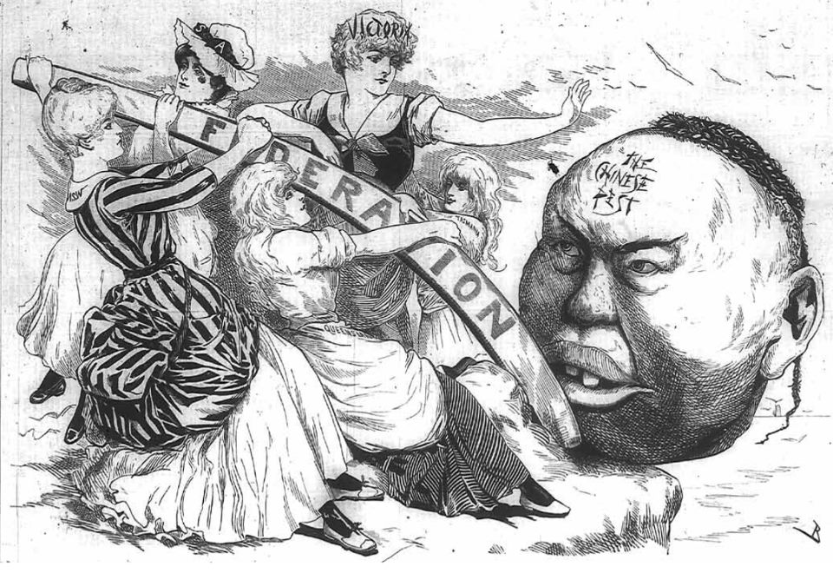
The Only Way
Cartoon of Victoria urging the Federation to get rid of the ‘Chinese pest’, Melbourne Punch, 10 May 1888, National Library of Australia.
Victoria. – ‘Girls, there’s but one way to rid ourselves of this unsightly thing, and that’s by all taking hold together. A strong unanimous heave with this lever and the job is done.’
Chorus. – ‘Yes and if John should be the means of bringing us together, we’d have something to thank the Chinese question for after all.’
(‘John’ is an abbreviated version of ‘John Chinaman’ – a racist term commonly used by white colonists at the time. )
Dot Point 1

Slide 15
United and Cohesive Nation An egalitarian nation, equal opportunities for all ( if you are white of course)
By 1900, 82% of Australians had been born here. This gave them a love & pride in their ‘Australianness’.
Along with this feeling of belonging came a need to forge a national identity.
Late 19th Century art, literature and journalism, were integral in the creation this new, albeit male, national identity.
Artists, such as Frederick McCubbin, Tom Roberts and Arthur Streeton captured the national character as a shearer, bushman or swagman in remote and uniquely Australian landscapes.
Poets, such as Henry Lawson wrote of the male experiences of the bush and bush life, reinforcing the values that came to define the national character.
The Bulletin magazine, founded in 1880, helped to perpetuate this new national identity through it’s radical, nationalist and ant-imperialistic material.
‘Australia didn’t like the mother country’s class-divisions, particularly the notion that when classifying human beings past and pedigree determined the future’ (Carlyon).
Dot Point 1
‘The convict derived bush ethos formed the most important basic component of the national mystique’ (Ward).
Notes:
http://www.ngv.vic.gov.au/australianimpressionism/education/insights_national.html

Slide 16
"No nigger, no chink, no lascar, no kanaka, no purveyor of cheap labour, is an Australian."
The Bulletin 1887
Dot Point 2

Slide 17
The Processes of Exclusion The processes of inclusion and exclusion which formed a nation of Australian citizens up to 1914.
The Constitution – Sections 51 and 127 excluded Aborigines from being counted in the census and denied the Commonwealth Govt the right to make laws for Aborigines. Thus rendering the aborigines invisible in the Constitution (Mirams).
Legislation - 1901-1914 was used to make some people welcome and valued and others excluded or marginalized
Social processes These were also used to include and exclude. Drunkenness and promiscuity were frowned upon, even if they were not against the law. Unmarried mothers were legally entitled to the Maternity Allowance but were shunned by society.
Dot Point 2

Slide 18
Surely it is absolutely repugnant to the greater number of the people of the Commonwealth that an Aboriginal man or Aboriginal lubra or gin – a horrible, degraded, dirty creature – should have the same rights that we have…decided to give to our wives and daughters.
Senator Alexander Matheson:
Aborigines-Conflicting Views
“It would be a monstrous thing, an unheard of piece of savagery on our part, to treat the Aboriginals, whose land we are occupying, in such a manner as to deprive them absolutely of any right to vote in their own country
Richard O’Connor, minister in Barton’s senate
Dot Point 2

Slide 19
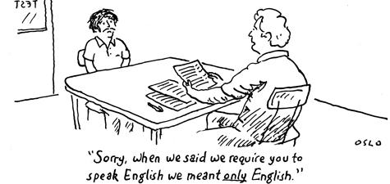
Legislation – a process of exclusion
Immigration Act and the Pacific Islanders Act - 1901
Together, these two pieces of legislation became known unofficially as. ‘The White Australia Policy’ (Mirams)
A key feature of the WAP was the Dictation Test, according to Lewis “It was a lie and a sham, but it was diplomatically acceptable’
Inferior races were to be excluded to preserve Australian society as pristine, harmonious and progressive (Hirst).
Lake refers to the Pacific Islanders Act as ‘a radical act of racial expulsion’
Swiftly enforced - A ‘disgrace to the British Empire’
Dot Point 2
Notes:
December 1903, shipwrecked sailors taken to Melbourne. The non-European crew were not allowed to step ashore and were put on a mail ship bound for Hong Kong. (Day, The Age 2001)

Slide 20
Inclusion? Exceptions to the rule
Immigration Restriction Act
‘A handsome New Years gift for the new nation’- Barton
Quong Tarts. Lewis explains that leaders of communities “seem to have been respected and accepted”.
Chinese in Bendigo – Easter festival
Federation Arch and parade
Pacific Islanders Act
‘All alien elements within it shall be diminished’ – Deakin. This refers to the deportation of Pacific Islanders under the Act. However some Islanders had been in QLD for a long time and had families and homes. So in response to the act they petitioned the King. “After a royal commission in 1906, a number of Islanders were allowed to remain. Their communities survived on the tropical east coast.” (Paul Kelly)
Franchise Act
Originally Aboriginal Australians were included in this Act and did have the right to vote. However, an amendment was later passed to exclude Aborigines of this right.
Dot Point 2

Slide 21
Inclusion through Legislation
Commonwealth Franchise Bill of 1902
The Conciliation and Arbitration Act of 1904
The Old Age and Invalid Pension Act of 1908
The Maternity Allowance Act of 1912
This Act gave women the right to vote extended a sense of inclusion to them
This Act encouraged equality and inclusion by establishing an independent judiciary – to hear disputes between employers and employees.
This Act was one of the most ‘progressive pieces of legislation of the time’ (Lewis) and reflected the growing Australian motif ‘of a fair go’ (Lewis).
Dot Point 2
This Act further included women (white) in the nation by extending their rights and providing them with £5 upon the birth of their child – more than double the basic wage.

Slide 22
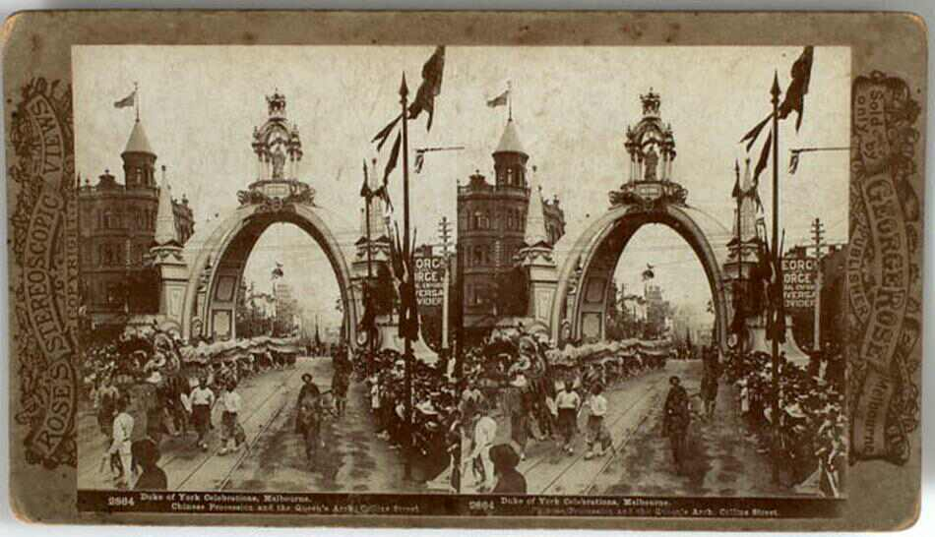
The Queen's Arch on Collins Street and a Chinese procession passing underneath.

Slide 23
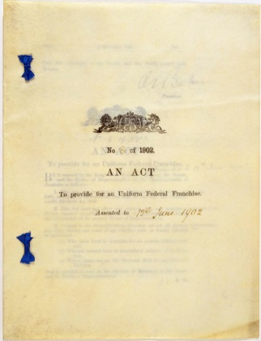
Benefits and Responsibilities The benefits and responsibilities extended to those who belonged to the new nation, including work, education and welfare legislation, women and motherhood, national defence and conscription.
This dot point requires you to have knowledge of the specific pieces of legislation passed in the period 1901-1914, the time of the new nation.
This simply means that you have to know the correct names and dates of the legislative acts.
When thinking about the legislation it is a good idea to ask each Act:
“What benefit is this providing to citizens?”
“What responsibility does this piece of legislation impart to the individual or community
Dot Point 3

Slide 24
Nine Acts
There were 9 Acts passed that helped shape the new nation and reflected the values of Australia at the time. These acts were:
Immigration Restriction Act 1901
Pacific Islanders Act 1901
Franchise Act 1902
The Customs Tariff Act 1902
Conciliation and Arbitration Act1904
Tariffs Acts and New Protection 1905-1907
Invalid and Old Age Pension Act 1908
Defence Act Amendment 1909
Maternity Allowance Act 1912
Dot Point 3

Slide 25
Benefits These benefits were largely extended to white males
Political rights – vote, right to stand for Parliament
Workers rights – Right to have disputes heard, right to basic wage, rights to pensions. “The Harvester Judgement said that wages should be based on the principle of human needs, not what the employer could afford to pay. “ (Paul Kelly)
Prosperity and high living standards – These were expected to follow from the above, plus laws such as 'The new Protection' and the establishment of the Commonwealth Bank.
Welfare –Right to basic wage, maternity allowance, Invalid and Aged pensions. “This proposal will relieve misery. . . It will also save lives. . . It will bring comfort . . . It will benefit the nation” (Watson)
Protection – Right to feel safe through military training, the establishment of a citizen army and the establishment of Australian Navy.
Dot Point 3

Slide 26
Benefits cont… These benefits were largely extended to white males
Education (state responsibility) – all children were entitled to a free primary education (to Year 8). Education was compulsory but Aboriginal children were not forced to go to school.
Health (state responsibility) – most people had access to medical care but the quality often depended on the wealth of the patient.
Sense of belonging and acceptance – most white people received messages through laws, political speeches, newspapers, literature, plays and paintings that they were members of one of the finest and most progressive societies in the world. They were encouraged to feel positive about Australia. In 1883, Englishman REN Twopenny visited Australia and he wrote:
'In Australia, a man feels himself a unit in the community, a somebody…This brings with it a greater sense of self-respect and responsibility.'
Dot Point 3

Slide 27
Responsibilities
All white men (and after 1902, all white women) - to vote and be engaged in the political process.
White males and boys as young as 12 – to undergo military training.
Employers – to pay the basic wage and provide ‘decent’ working conditions (for the time)
Workers – to work hard and contribute to the nation’s prosperity.
White women – to produce white babies. “The more Australians we have, the wealthier we must be” (Fisher)
Governments (State and Commonwealth) to pass laws that would look after the welfare of the citizens, especially in areas of education and public health.
All - Continue to support the Empire.
Dot Point 3

Slide 28
Excluded
Some or all of these benefits were denied to:
Most Aborigines (Welfare)
Most South Sea Islanders (Welfare)
Most Chinese (Welfare)
Some Women and children (Maternity allowance)
Some workers
Some town and city dwellers
Dot Point 3

Slide 29
Useful Websites
Our Pinterest Page
http://www.pinterest.com/sallyluane/
Ergo (for study skills)
http://ergo.slv.vic.gov.au/learn-skills/study-skills

