Slide 1
Why I use Facebook in the class room and ‘like’ it

Slide 2
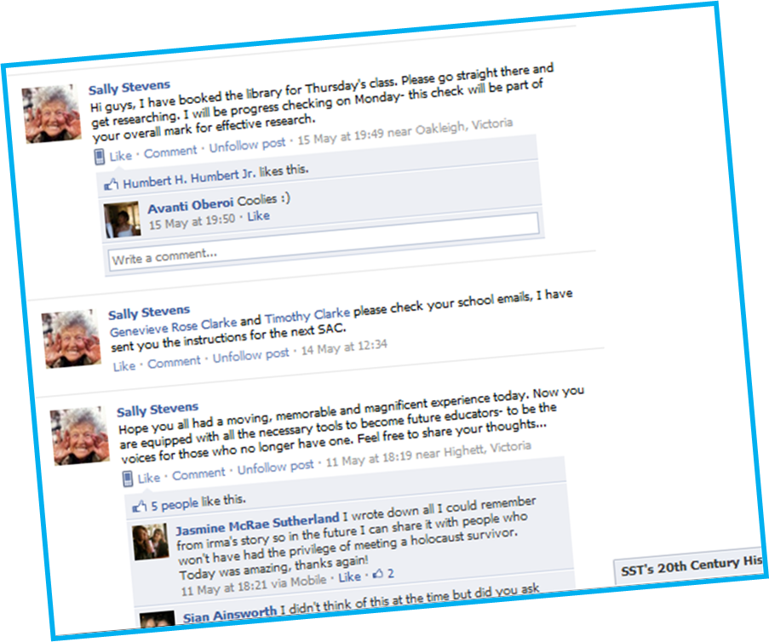
Instructions for future lessons
Questions for discussion
-After excursions
-After important lessons

Slide 3
Posting content missed in lessons
-Videos
-Worksheets
-Readings
-PowerPoints

Slide 4
Instant uploading of class documents and PowerPoints missed by absent students

Slide 5
Pre-teaching and engaging students with visual prompts that do not require students to access external sites.

Slide 6
Direct links to YouTube allows you have the flexibility to ‘flip’ the classroom or give students access to content used in class to watch again or use for revision.

Slide 7
A place to collect and save thoughts after excursions.

Slide 8
Creating a more positive and supportive environment through better teacher-student relationships

Slide 9
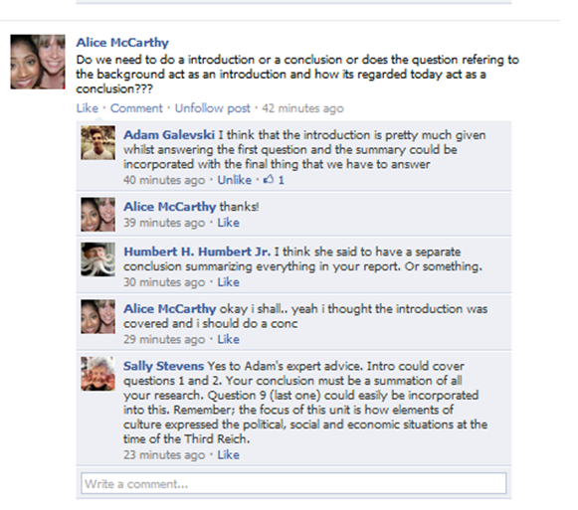
And, The most important feature of all…Students teaching students
Notes:
Students teaching students

