Slide 1
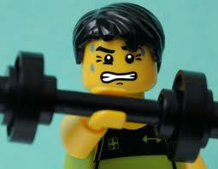
What Makes You Say That?
Practical ways to strengthen and improve literacy and thinking skills.

Slide 2
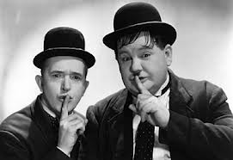
How important is literacy and the need to make thinking visible in our classrooms?
Silent Conversation
Notes:
Having a written conversation with peers slows down students’ thinking process and gives them an opportunity to focus on the views of others. This strategy also creates a visual record of students’ thoughts and questions that can be referred to later in a course. 10mins

Slide 3
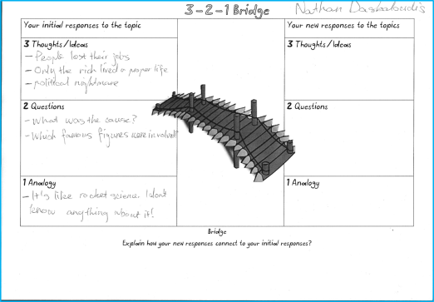
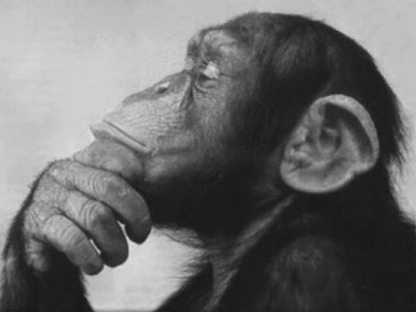
Visible thinking in action
Visible thinking;
Helps students to gain a deeper understanding of content.
Students have a greater motivation for learning.
Helps to develop the learners' thinking and learning abilities.
Helps to develop learners' attitudes toward thinking and learning and their alertness to opportunities for thinking and learning.
Helps to create a community of enthusiastically engaged thinkers and learners.
Notes:
To find out more about visible thinking, please go to: http://pzweb.harvard.edu/vt/VisibleThinking_html_files/03_ThinkingRoutines/03a_ThinkingRoutines.html Here you will find many examples of thinking routines in use and instructions on how to use them.

Slide 4
See Think Wonder
What can you see?
What does it make you wonder?
It encourages learners to critically observe and interpret what they see.
What do you think about that?
Notes:
The easiest thinking routine to incorporate into your lessons. It encourages learners to critically observe and interpret what they see.

Slide 5
First Impressions The image below was taken in Terezin Concentration Camp. Look at it carefully , what can you see? What do you think is going on and what does it make you wonder?

Slide 6
Literacy involves students listening to, reading, viewing, speaking, writing and creating oral, print, visual and digital texts, and using and modifying language for different purposes in a range of contexts.
Acara, 2012
MCEETYA (2008), recognises literacy as an essential skill for students in becoming successful learners and as a foundation for success in all learning areas. Success in any learning area depends on being able to use the significant, identifiable and distinctive literacy that is important for learning and representative of the content of that learning area.
Acara, 2012

Slide 7
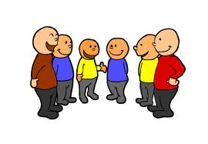
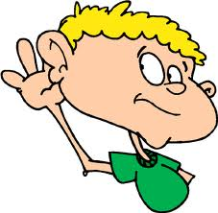
Writing
Viewing
Reading
Talking
Listening
Literacy
Elements
Technology
Creativity

Slide 8
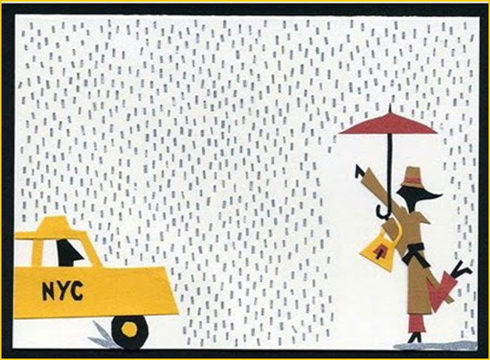
Can someone call me a Vocab?
VO-CAB
Vocabulary is a principle contributor to comprehension, fluency, and achievement. Vocabulary development is both an outcome of comprehension and a precursor to it, with word meanings making up as much as 70–80% of comprehension.
Davis, 1972; Nagy & Scott, 2000; Pressley, 2002
Students with large vocabularies understand text better and score higher on achievement tests than students with small vocabularies
Stahl &Fairbanks, 1986
Today we will be focusing on ways in which we can improve student literacy in our classrooms. We can achieve this through the explicit teaching of subject specific vocabulary, and the inclusion of regular thinking routines and reading strategies in our teaching practice.
Notes:
The focus of this presentation is improving our student’s vocabularies. We can achieve this by incorporating thinking routines in our classrooms, by making use of visual stimulus and graphic organisers and by identifying and developing key vocabulary.

Slide 9
1. Securing the scene Thinking routines and literacy strategies for lesson or unit starters.
Word Triangle
Silent Conversation
Wall Displays
Word Splash
3-2-1 Bridge
Visual Glossaries – Using Popplet

Slide 10
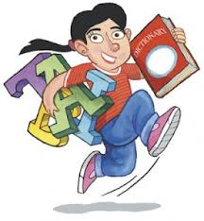
Word Triangle
What?
This is an activity I use to introduce a new concept. In 3 minutes, students have to find as many words (3 letters minimum) as they can using the available letters.
Why?
It is great for developing vocabularies and engaging students. It can also calm a straight-after-lunch crowd.
It is also teacher friendly, as it allows the teacher time to set up the class (projector)
C
R O
M E
O P E
N S I
N H

Slide 11
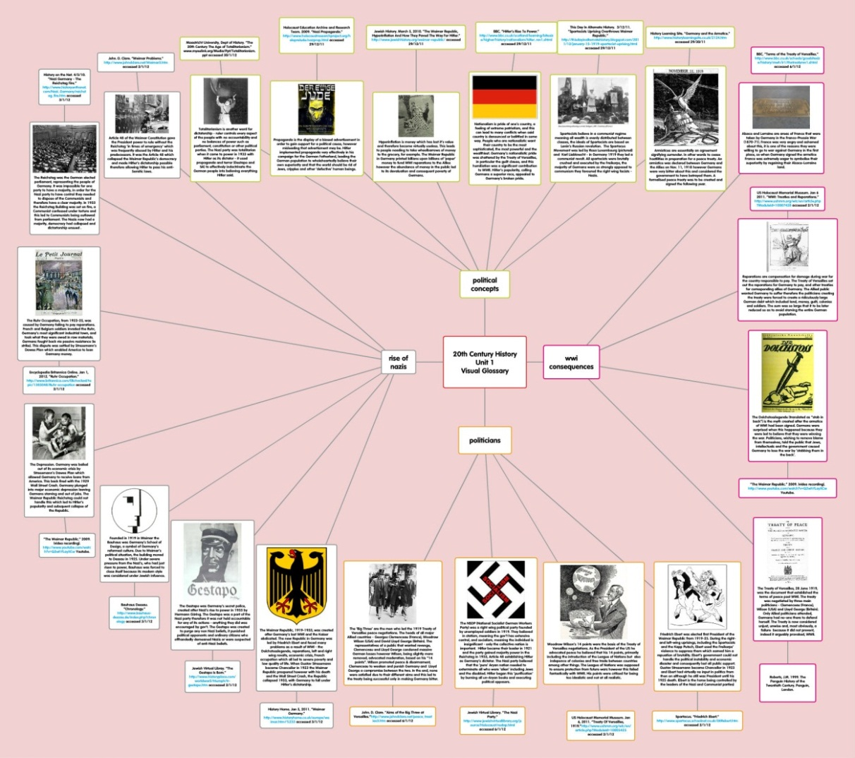
Visual Glossaries with
When?
Great at the beginning of a unit, especially for holiday homework.
Why?
Students are creating word banks that are subject specific to assist in future readings.
Students are exposed to the content of the unit when researching their definitions.

Slide 12
WORDS IN HISTORY
Always
Bad/Good
Proved
Everyone
All
In all cases
I think that…
Proves/Proof
My view is…
Everyone thought that
Here is a quote…

Slide 13
Word Splash The word splash activity supports students’ reading by helping to provide purpose.
Student generated word splash
Students brain storm all the words they associate with the topic of the article/chapter/worksheet they will soon be reading.
Teacher generated word splash
A teacher generated word splash can be used when students are reading an article on a topic that may not be easily accessible to students.

Slide 14
Word Splash example for unit : The Great Depression Listed below are some of the words that feature in the following PowerPoint presentation. Do you know what these words mean? Write down any words you are unsure of, and find out their meaning. Write this ‘new’ word in a sentence to help you with your understanding.
Agencies
Honest
Audience
Intend
Broadcast fighter
unemployment
New Deal
Pension
Agricultural Industry
Hope
Crisis
Implement prosperity
Relief
Reform honesty

Slide 15
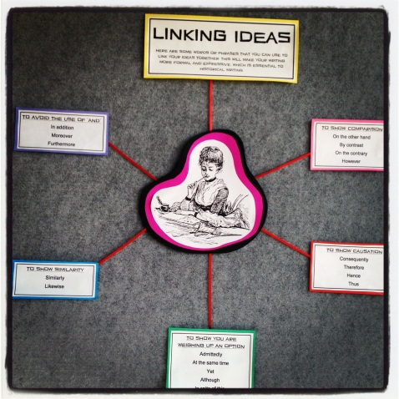
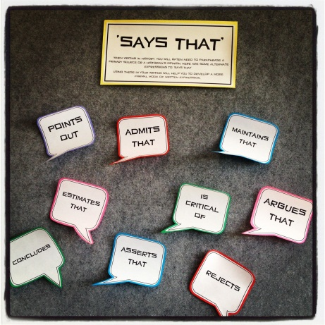
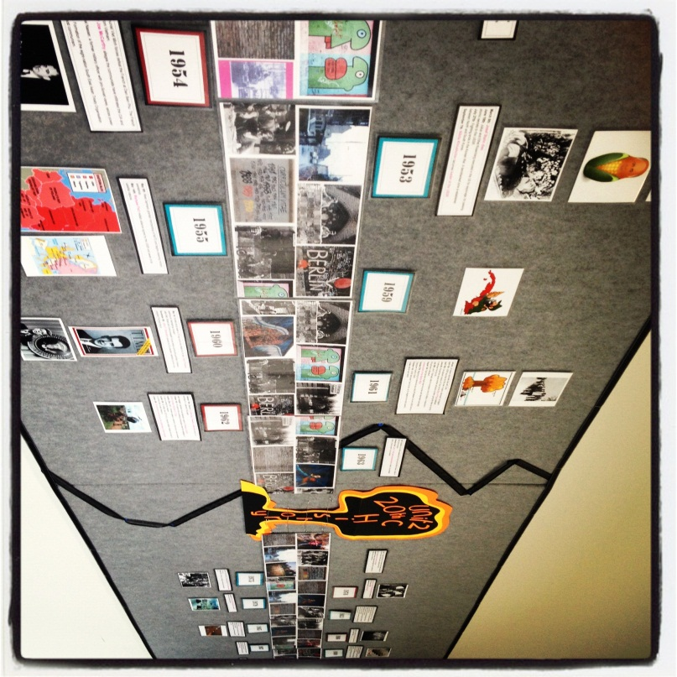
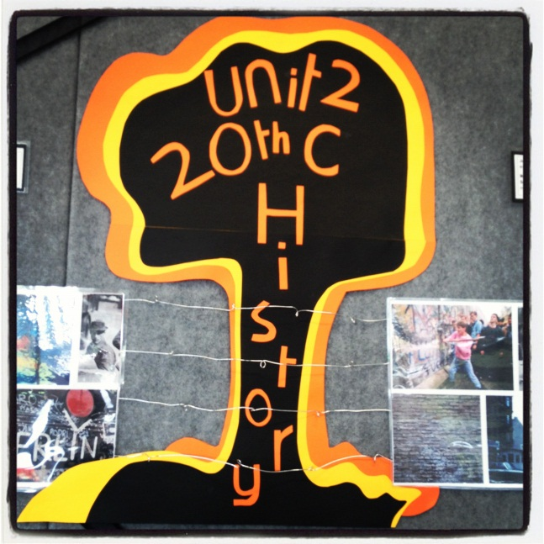
Wall Displays
Creates a culture of thinking.
Creative classroom displays can capture students' attention and stimulate learning.
Help to consolidate learning, reinforce key concepts and skills from prior lessons.

Slide 16
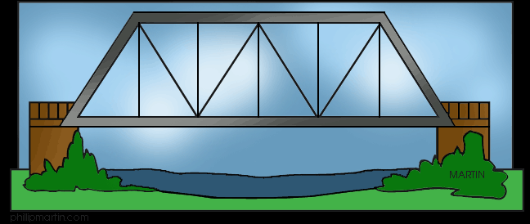
3-2-1 Bridge thinking routine
Your initial (first) responses to the topic
3Thoughts about the topic
I think that….
2 Questions you have about the topic
How/what/when/who/why/where
1 Analogy you can make about the topic
Your new responses to the topic
3 Thoughts about the topic
I now think that…
2 Questions you have about the topic
How/what/when/who/why/where
1 Analogy you can make about the topic
Notes:
Great to use when beginning a new topic to assess prior knowledge Highlighting these:
An analogy is a comparison between two different things in order to highlight some point of similarity.
Pupils are more like oysters than sausages. The job of teaching is not to stuff them and then seal them up, but to help them open and reveal the riches within. There are pearls in each of us, if only we knew how to cultivate them with ardor and persistence. (Sydney J. Harris, "What True Education Should Do," 1964)

Slide 17
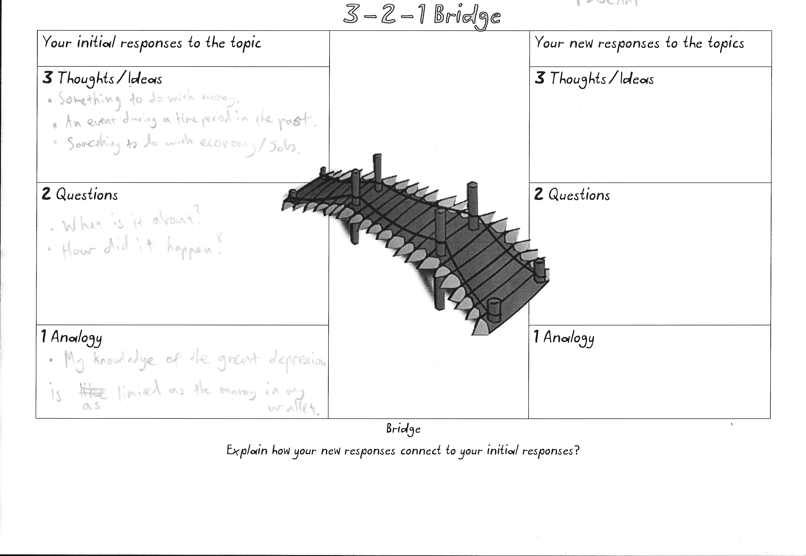
Three things I know
Something to do with money
An event during a time period in the past.
Something to do with economy
Two questions I have
What is it about?
How did it happen?
My analogy for this topic.
My knowledge of the great depression is as limited as the money in my wallet

Slide 19
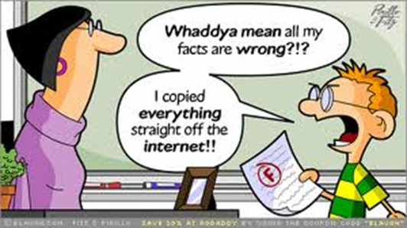
2. Walk through Ideas for improving reading skills and aiding comprehension
CSI- Colour Symbol Image
Coding Text
Jigsaw reading

Slide 20
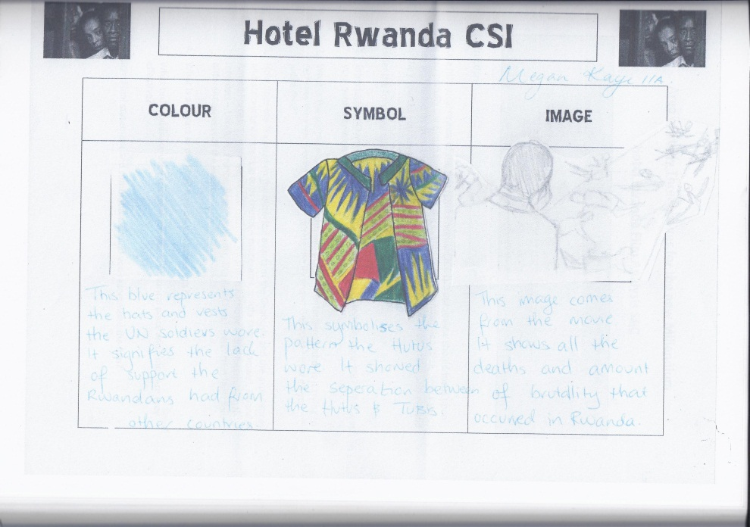
CSI- Thinking Routine
What?
A C S I is a non-verbal thinking routine that can be used to see student’s thoughts and informally assess student understanding. Great for use with EAL students or low level students.
When?
This activity is great for use after watching a film or documentary, after a museum visit, after reading or at the end of a unit.
It can also be used to get to know your students
It can be used to better understand key historical figures.

Slide 21
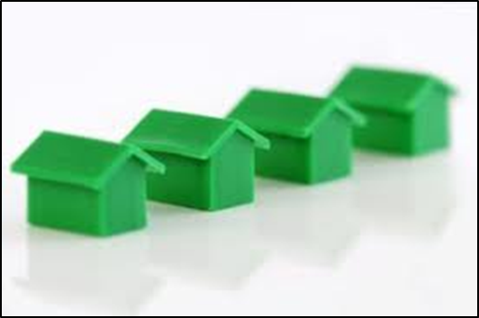
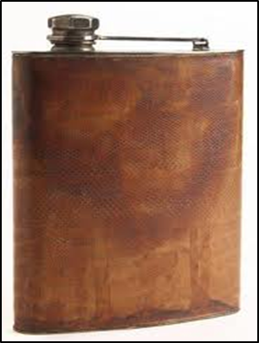
Yad Vashem Museum visit C.S.I Thinking Routine
Colour
Symbol
Image
In January 2012, I took part in the Gandel Australian Educators Program at Yad Vashem, Israel. This was the CSI I presented to the sponsors of our study grants upon our return.
Notes:
Colour= represents the cold, hard metal instruments used to determine ‘Jewishness’ of the people. On display at the museum
Symbol= represents the rows of barracks used to house the prisoners in various camps, but also the homes of the Jews in pre-war Jewish life- homes that they will never be able to return to. Homes that will remain empty.
Image= This represents the story told on camera at the end of the exhibit. The hip flask of whisky given to a prisoner on the day of liberation. After spending weeks/years in the camp starving to death and witnessing horror after horror, the suvivor almost died at the hands of his liberator because he handed him a drop of whisky.

Slide 22
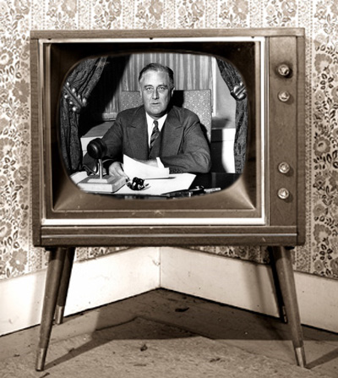
Your turn

Slide 23
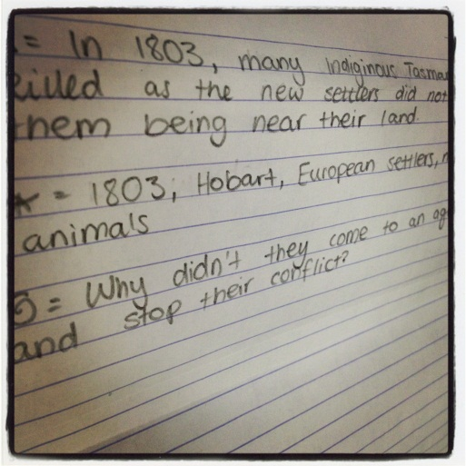
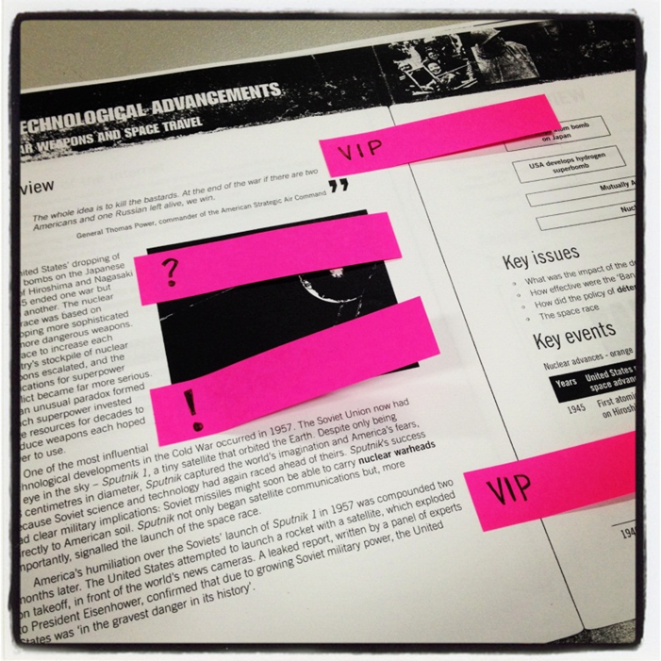
Coding Text
Tired of students reading without purpose?
Do you want students to be active thinkers as they read?
Do you want students to react to what they are reading?
Would you like to see student’s thinking as they read?
Then these strategies are for you!
Notes:
In a shape summary reading, students read chunks of information at a time rather than a whole chapter.
At the end of each paragraph read, they make notes on important facts (triangle), key words (asterisk) and anything puzzling (spiral)

Slide 24
Shape Summaries A great strategy for reading large amounts of information
Students gain more understanding if they read CHUNKS of information rather than large slabs.
In this reading strategy, students use shapes to code different types of information as they read. For example:
= Important facts and information
= Key words in the text
= Any information that is puzzling or questions needed to ask.
Notes:
Get images of chocolate to demonstrate this.

Slide 25
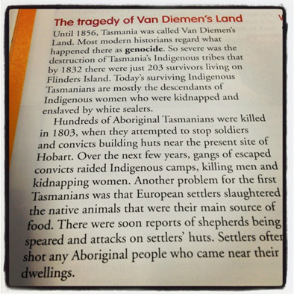
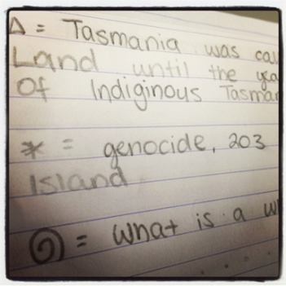
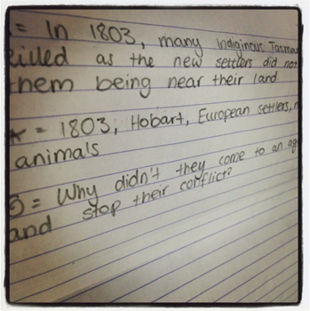
Shape Summaries A great strategy for reading large amounts of information
Students complete a shape summary for each of the paragraphs they read.
At the end of their reading and completion of their shape summaries, students are to write a detailed summary of everything they read. (using only their shape summaries)
To reinforce the benefit of doing ‘shape summaries’ first, I ask students to close their books or throw away their reading.
Students are often amazed by how much they are able to write.
Great for weaker students.

Slide 26
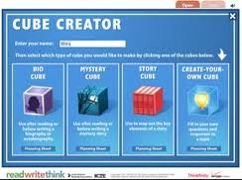
Bio-Cubes
When
Great to leave for an extra
What
This is an activity that helps students to synthesise information

Slide 27
3. Bag and Tag Thinking routines and literacy strategies for ending the lesson.
Exit Slips
What?
Exit slips are written student responses to questions you pose at the end of class. At the end of the school day, or at the end of an important learning activity is an excellent time to use exit slips.
Why?
They are great for a quick assessment tool, also good for diagnostic assessment and a vehicle for planning future lessons.
Variation
This can be used as an entry slip, used in conjunction with homework. A way to begin the lesson and focus students’ thinking.
Headlines
What?
Used to get the students to summing up and capturing the essence of a concept, idea or topic.
How?
The routine asks one core question:
If you were to write a headline for this topic or issue right now that captured the most important aspect that should be remembered, what would that headline be?

Slide 28
One Last Thing…
25 words
What?
In this activity students are asked to write a 25 word definition of a concept or idea covered in class. The key is to write only 25 words, no more and no less.
Why?
This encourages the wafflers to be succinct and the strugglers to extend themselves.

Slide 29
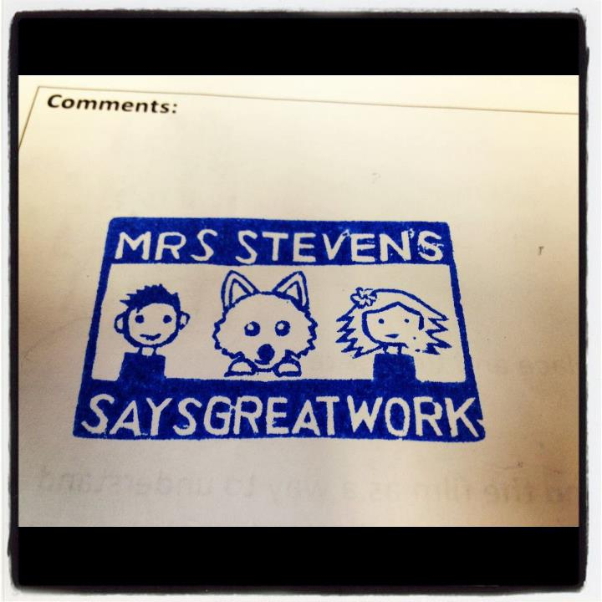
Thank you for taking part in this workshop.
If you would like information on any other thinking routines or literacy strategies, please email:
sst@gwsc.vic.edu.au

Slide 30
Acknowledgements
Visible Thinking Routines
http://pzweb.harvard.edu/vt/VisibleThinking_html_files/03_ThinkingRoutines/03a_ThinkingRoutines.html
Vocabulary quotes
http://www.australiancurriculum.edu.au/GeneralCapabilities/Literacy/Introduction/Introduction
Literacy
Handouts, courtesy of R Cooney, Literacy Coordinator at GWSC.
YouTube Clip
http://www.youtube.com/watch?v=518XP8prwZo

